Slide 1
Fundamentals of Deep Neural Networks

Slide 2
Motivation

Slide 3
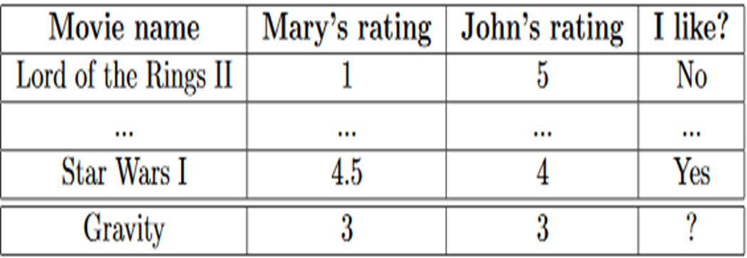
A Motivating Problem
Movie recommendation:
You have two friends John and Mary. You have prior data telling the movies you liked or disliked that they rated. Now a new movie named ‘gravity’ has been released that they rated and you want to decide whether you should watch it.

Slide 4
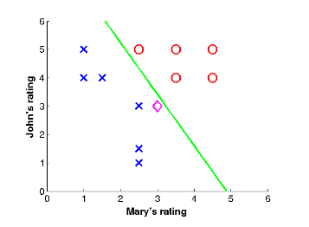
Movie Recommendation
Plot of the data:
You liked
New movie
You disliked
Observation: the classes can be separated by straight line

Slide 5
Movie Recommendation
How can you predict the label for new movie, gravity?
Answer: Logistic regression

Slide 6

Logistic Regression: Graphical View
represented by z
$$x_{1}$$
$$w_{1}$$
f(z)
output
$$x_{2}$$
$$w_{2}$$
$$b$$
$w_{1}$ weight of feature ${ x}_{1}$
$w_{2}$ weight of feature $x_{2}$
b is called bias
$z=w_{1}∗x_{1}+w_{2}∗x_{2}+b$
$f\left(z\right)=e^{z}/(1+e^{z})$, called the activation function
For this sample, what will be value of z?
positive or negative?
What will be the output given by f(z)?
> 0.5
What the logistic regression is doing actually?
Given an input sample, it is telling which side of the straight line the sample lies.

Slide 7
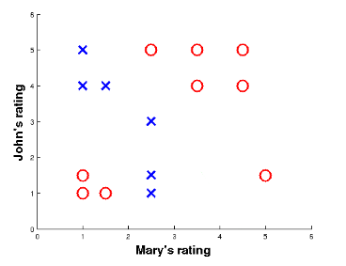
Limitations of Linear Decision Function
Now consider a data like this:
The decision function involves two straight lines
Thus, we need to combine information from two straight lines

Slide 8

Addressing Non-linearity
Moral of the story:
Hidden nodes help make decision in complex cases
In classification, the complex case means highly non-linear decision boundary that separates the classes
More hidden layers you take, more complex decision your model can make
Here is a good network
$$x_{1}$$
$$w_{1}$$
f
$$w_{5}$$
$$w_{2}$$
$$b_{1}$$
f
output
$$w_{3}$$
$$x_{2}$$
f
$$w_{6}$$
$$w_{4}$$
$$b_{2}$$
The shaded nodes are called hidden nodes / neurons
Each hidden node corresponds to one straight line in the data

Slide 9
Structure of Deep Network

Slide 10

Structure of Deep Network
output
Components of Deep network
One input layer with a set of nodes that take the feature values for a sample
# nodes in this layer = dimension of the data = # features
One output layer with a set of nodes, that gives the class labels
# nodes in this layer = # class label in the training data
Multiple hidden layers, each layer contains a set of nodes
Higher the number of hidden layers, deeper the network

Slide 11
Ingredients of a Deep Network

Slide 12

Ingredients of a Deep Network
Things you need to have in order to describe a deep network:
1. Weight (strength of connection) from one node to the another node in the next layer
$w_{ij}^{l}→connection weight of node i in layer l to the node j in layer l+1$
2. Bias of each non-input node
$b_{i}^{l}→bias of node i in layer l$
3. Activation function inside each non-input node
Ex: sigmoid function

Slide 13
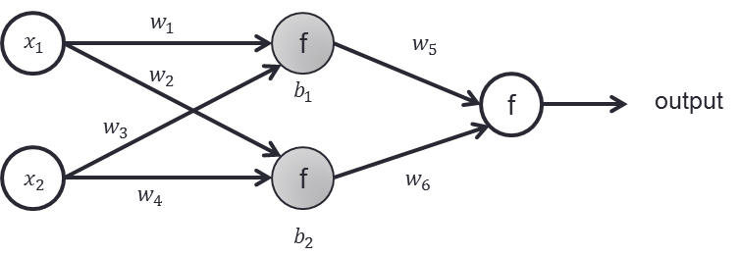
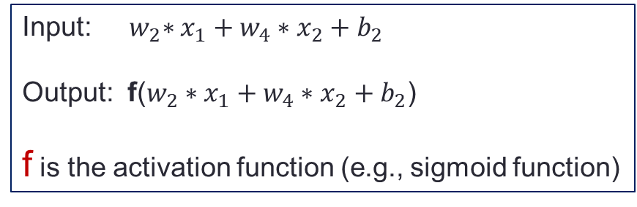
Ingredients of a Deep Network
What does a non-input neuron of the network do?
Each node takes inputs from nodes from previous layer,
linearly combines them,
and then passes through the activation function
Input: ${ w}_{2}∗x_{1}+w_{4}∗x_{2}+b_{2}$
Output: f($w_{2}∗x_{1}+w_{4}∗x_{2}+b_{2}$)
f is the activation function (e.g., sigmoid function)

Slide 14
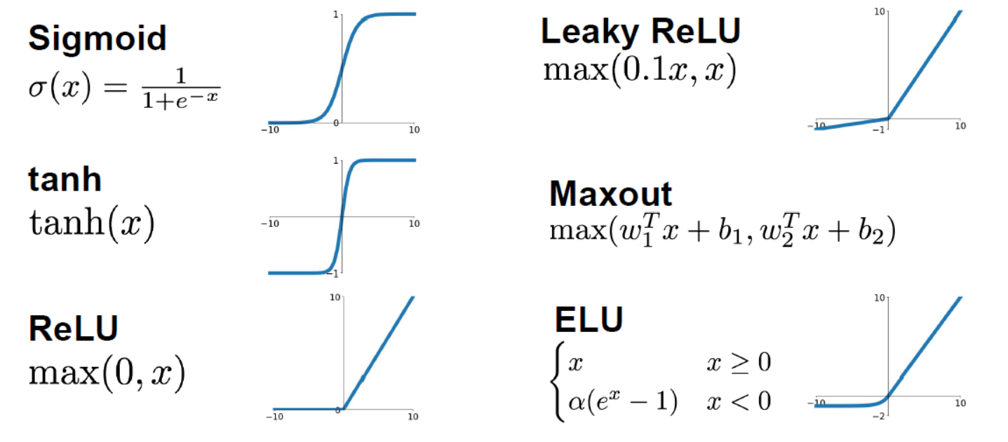
Activation Function

Slide 15

Deep vs. Shallow Network
What is the # features of the data the deep network trying to model?
How many class labels are there in that data?
How many parameters the deep net has?

Slide 16
Training Deep Network

Slide 17
Backpropagation Algorithm The Pillar of Deep Learning

Slide 18
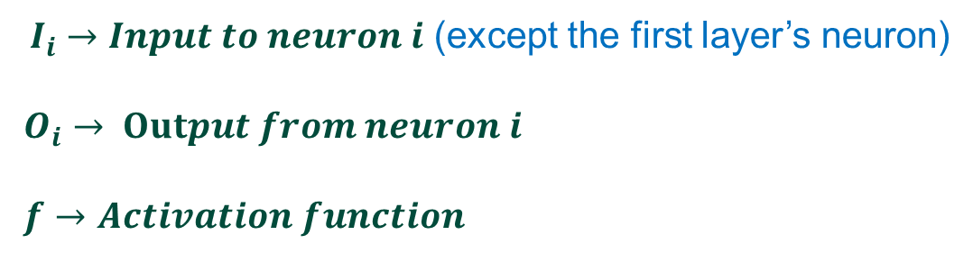
Training Neural Network
Let us start with the simplest network:
One feature, 2 class, 2 hidden nodes
$$b_{1}$$
$$b_{2}$$
$$b_{3}$$
$$w_{1}$$
$$w_{2}$$
$$w_{3}$$
x
1
2
3
$O_{3}$ (output)
$$I_{1}=w_{1}∗x+b_{1}$$
$$I_{2}=w_{2}∗{ f(I}_{1})+b_{2}$$
$$I_{3}=w_{3}∗f(I_{2})+b_{3}$$
$$O_{1}=f(I_{1})$$
$$O_{2}=f(I_{2})$$
$$O_{3}=f(I_{3})$$
${ I}_{i} →Input to neuron i$ (except the first layer’s neuron)
$O_{i}$ $→$ $Output from neuron i$
$f→Activation function$

Slide 19
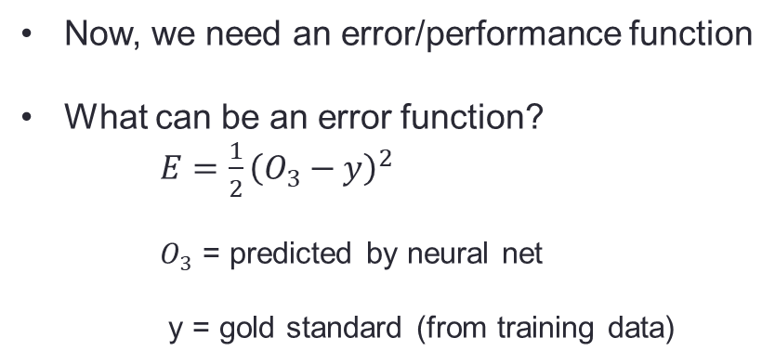
Training Neural Network
$$b_{1}$$
$$b_{2}$$
$$b_{3}$$
$$w_{1}$$
$$w_{2}$$
$$w_{3}$$
x
1
2
3
$O_{3}$ (output)
$$I_{1}=w_{1}∗x+b_{1}$$
$$I_{2}=w_{2}∗{ f(I}_{1})+b_{2}$$
$$I_{3}=w_{3}∗f(I_{2})+b_{3}$$
$$O_{1}=f(I_{1})$$
$$O_{2}=f(I_{2})$$
$$O_{3}=f(I_{3})$$
Now, we need an error/performance function
What can be an error function?
$E=\frac{1}{2}{\left(O_{3}−y\right)}^{2}$
$O_{3}$ = predicted by neural net
y = gold standard (from training data)

Slide 20
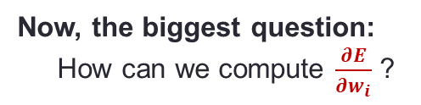
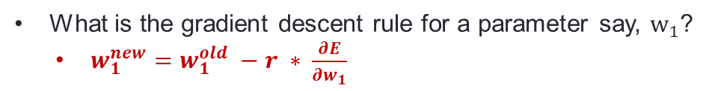
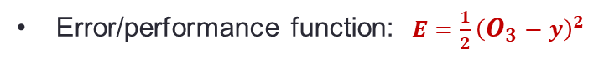
Training Neural Network
$$b_{1}$$
$$b_{2}$$
$$b_{3}$$
$$w_{1}$$
$$w_{2}$$
$$w_{3}$$
x
1
2
3
$O_{3}$ (output)
$$I_{1}=w_{1}∗x+b_{1}$$
$$I_{2}=w_{2}∗{ f(I}_{1})+b_{2}$$
$$I_{3}=w_{3}∗f(I_{2})+b_{3}$$
$$O_{1}=f(I_{1})$$
$$O_{2}=f(I_{2})$$
$$O_{3}=f(I_{3})$$
Error/performance function: $E=\frac{1}{2}{\left(O_{3}−y\right)}^{2}$
How can we find good values of parameters?
Answer: By gradient descent
What is the gradient descent rule for a parameter say, $w_{1}$?
$w_{1}^{new}=w_{1}^{old} −r ∗ \frac{∂E}{∂w_{1}}$
Now, the biggest question:
How can we compute $\frac{∂E}{∂w_{i}}$ ?

Slide 21
Training Neural Network
$$b_{1}$$
$$b_{2}$$
$$b_{3}$$
$$w_{1}$$
$$w_{2}$$
$$w_{3}$$
x
1
2
3
$O_{3}$ (output)
$$I_{1}=w_{1}∗x+b_{1}$$
$$I_{2}=w_{2}∗{ f(I}_{1})+b_{2}$$
$$I_{3}=w_{3}∗f(I_{2})+b_{3}$$
$$O_{1}=f(I_{1})$$
$$O_{2}=f(I_{2})$$
$$O_{3}=f(I_{3})$$
Error/performance function: $E=\frac{1}{2}{\left(O_{3}−y\right)}^{2}$
Let us compute gradients:
$\frac{∂E}{∂w_{3}}$ =
$\frac{∂E}{∂O_{3}}$
$\frac{∂O_{3}}{∂I_{3}}$
$\frac{∂I_{3}}{∂w_{3}}$
$$×$$
$$×$$
$\frac{∂E}{∂w_{2}}$ =
$\frac{∂E}{∂O_{3}}$
$\frac{∂O_{3}}{∂I_{3}}$
$\frac{∂I_{3}}{∂O_{2}}$
$\frac{∂O_{2}}{∂I_{2}}$
$\frac{∂I_{2}}{∂w_{2}}$
The chain rule of derivative
$$×$$
$$×$$
$$×$$
$$×$$
$\frac{∂E}{∂w_{1}}$ =
$\frac{∂E}{∂O_{3}}$
$\frac{∂O_{3}}{∂I_{3}}$
$\frac{∂I_{3}}{∂O_{2}}$
$\frac{∂O_{2}}{∂I_{2}}$
$\frac{∂I_{2}}{∂O_{1}}$
$\frac{∂O_{1}}{∂I_{1}}$
$\frac{∂I_{1}}{∂w_{1}}$
$$×$$
$$×$$
$$×$$
$$×$$
$$×$$
$$×$$

Slide 22
Training Neural Network: Computing Gradients
$$b_{1}$$
$$b_{2}$$
$$b_{3}$$
$$w_{1}$$
$$w_{2}$$
$$w_{3}$$
x
1
2
3
$O_{3}$ (output)
$$I_{1}=w_{1}∗x+b_{1}$$
$$I_{2}=w_{2}∗{ f(I}_{1})+b_{2}$$
$$I_{3}=w_{3}∗f(I_{2})+b_{3}$$
$$O_{1}=f(I_{1})$$
$$O_{2}=f(I_{2})$$
$$O_{3}=f(I_{3})$$
Error/performance function: $E=\frac{1}{2}{\left(O_{3}−y\right)}^{2}$
gradients: the common parts
$\frac{∂E}{∂w_{3}}$ =
$\frac{∂E}{∂O_{3}}$
$\frac{∂O_{3}}{∂I_{3}}$
$\frac{∂I_{3}}{∂w_{3}}$
$\frac{∂E}{∂w_{2}}$ =
$\frac{∂E}{∂O_{3}}$
$\frac{∂O_{3}}{∂I_{3}}$
$\frac{∂I_{3}}{∂O_{2}}$
$\frac{∂O_{2}}{∂I_{2}}$
$\frac{∂I_{2}}{∂w_{2}}$
$$×$$
$$×$$
$$×$$
$$×$$
$$×$$
$$×$$
$\frac{∂E}{∂w_{2}}$ =
$\frac{∂E}{∂O_{3}}$
$\frac{∂O_{3}}{∂I_{3}}$
$\frac{∂I_{3}}{∂O_{2}}$
$\frac{∂O_{2}}{∂I_{2}}$
$\frac{∂I_{2}}{∂w_{2}}$
$\frac{∂E}{∂w_{1}}$ =
$\frac{∂E}{∂O_{3}}$
$\frac{∂O_{3}}{∂I_{3}}$
$\frac{∂I_{3}}{∂O_{2}}$
$\frac{∂O_{2}}{∂I_{2}}$
$\frac{∂I_{2}}{∂O_{1}}$
$\frac{∂O_{1}}{∂I_{1}}$
$\frac{∂I_{1}}{∂w_{1}}$
$$×$$
$$×$$
$$×$$
$$×$$
$$×$$
$$×$$
$$×$$
$$×$$
$$×$$
$$×$$
Which gradient you want to compute first? $\frac{∂E}{∂w_{3}}$, $\frac{∂E}{∂w_{2}}$ or $\frac{∂E}{∂w_{1}}$?
Why?
This method is known as backpropagation

Slide 23
Other Important Details

Slide 24
Parameter Initialization
Very large initialization leads to exploding gradients
Very small initialization leads to vanishing gradients
We need to maintain a balance

Slide 25
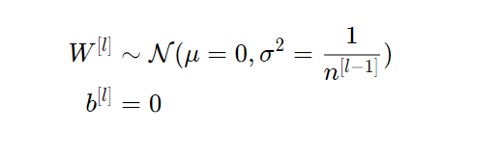
Initialization
Xavier initialization
For every layer l, set the parameters according to normal distribution
$n^{\left[l−1\right]}$ is the number of neurons in layer (l-1)

Slide 26
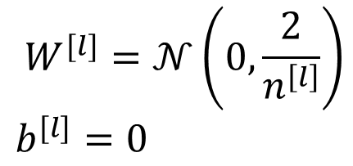
Initialization
Kaiming Initialization
$$W^{[l]}=𝒩\left(0,\frac{2}{n^{\left[l\right]}}\right)$$
$$b^{[l]}=0$$
For every layer l, set the parameters according to normal distribution
$n^{\left[l\right]}$ is the number of neurons in layer (l)

Slide 27
Computing Loss

Slide 28
Cross Entropy

Slide 29
Batch Normalization

Slide 30
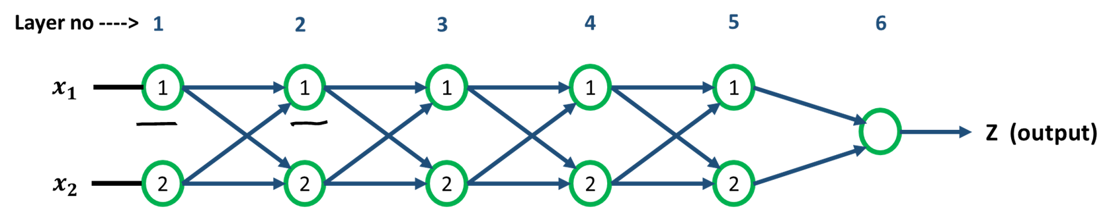

Slide 31
Internal Covariance Shift
Each layer of a neural network has inputs with a corresponding distribution
It generally depends on
the randomness in the parameter initialization and
the randomness in the input data.
These effect on the internal layers during training is called internal covariate shift.

Slide 32

Batch Normalization: Main idea
Normalize distribution of each input feature in each layer across each minibatch to N(0, 1)
Scale and shift

Slide 33

Batch Normalization: How to do?
Normalize distribution of each input feature in each layer across each minibatch to N(0, 1)
Learn the scale and shift

Slide 34
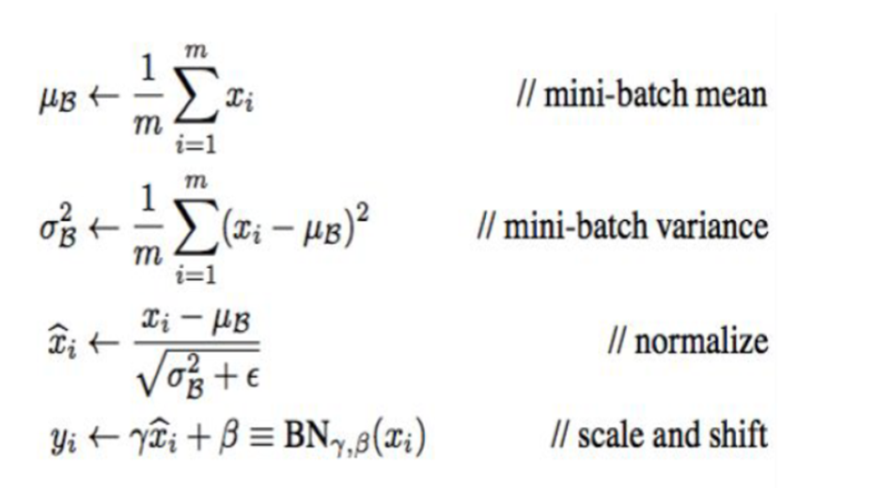
Batch Normalization: How to do?
Normalize distribution of each input feature in each layer across each minibatch to N(0, 1)
Learn the scale and shift
$γ and β$ are trainable parameters.
find using backprop
Loffe & Szegedy

Slide 35
Regularization

Slide 36
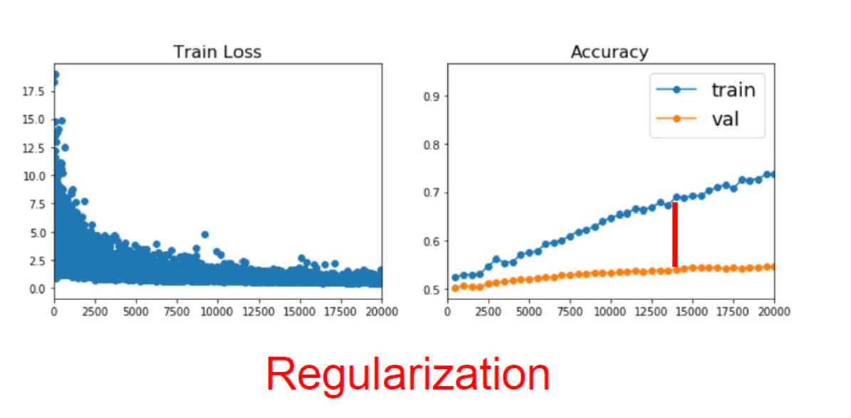
Improving Single Model Performance

Slide 37
Regularization
Key idea
Add a term to the error/loss function

Slide 38
Regularization
Key idea
Add a term to the error/loss function

Slide 39
Regularization
Key idea
Add a term to the error/loss function

Slide 40
Regularization
Key idea
Add a term to the error/loss function

Slide 41
Convolutional Neural Network

Slide 42
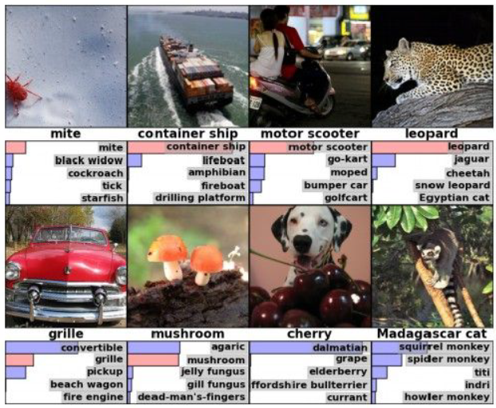
CNN Applications: Image Classification
Source: Alex Krizhevsky, 2012

Slide 43
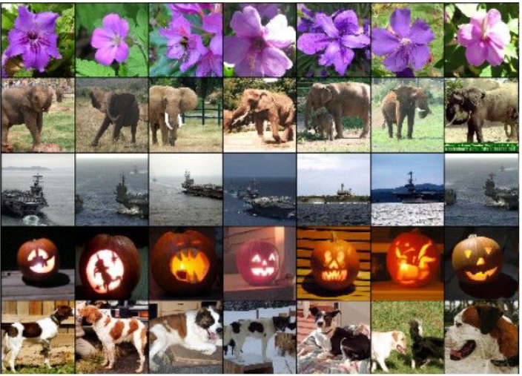
CNN Applications: Image Retrieval
Source: Alex Krizhevsky, 2012

Slide 44
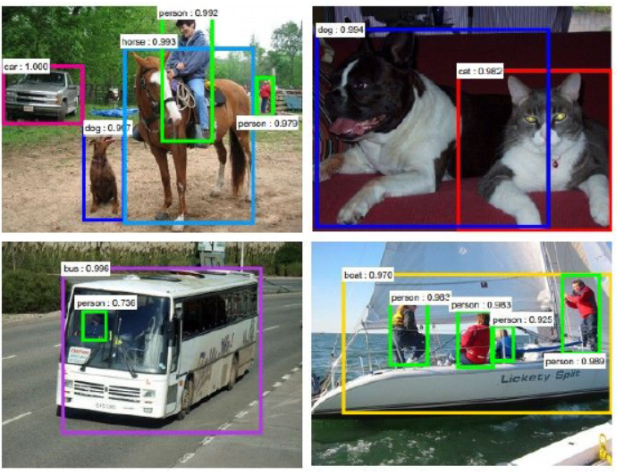
CNN Applications: Object Detection
Source: Faster R-CNN: Ren, He, Girshick, Sun 2015

Slide 45
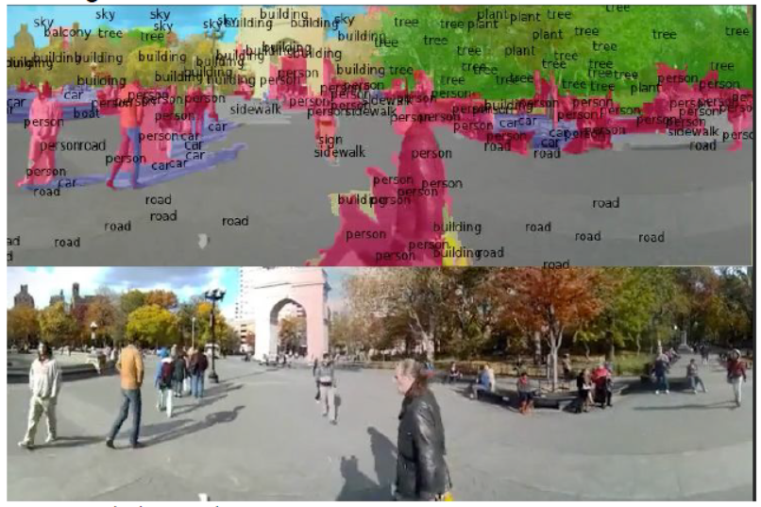
CNN Applications: Segmentation
Source: Farabet et al., 2012

Slide 46
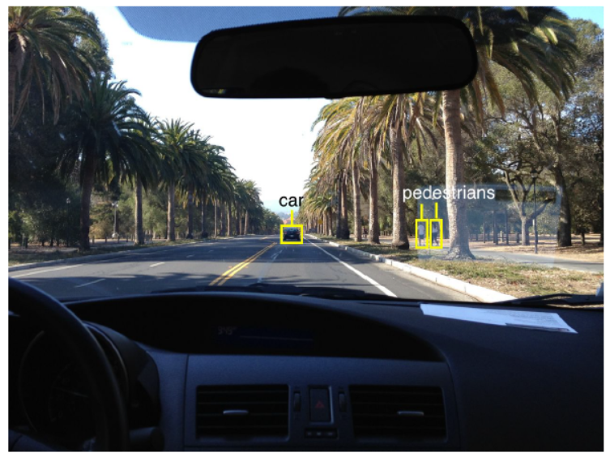
CNN Applications: Self Driving Car
Source: Fei Fei Li slides

Slide 47
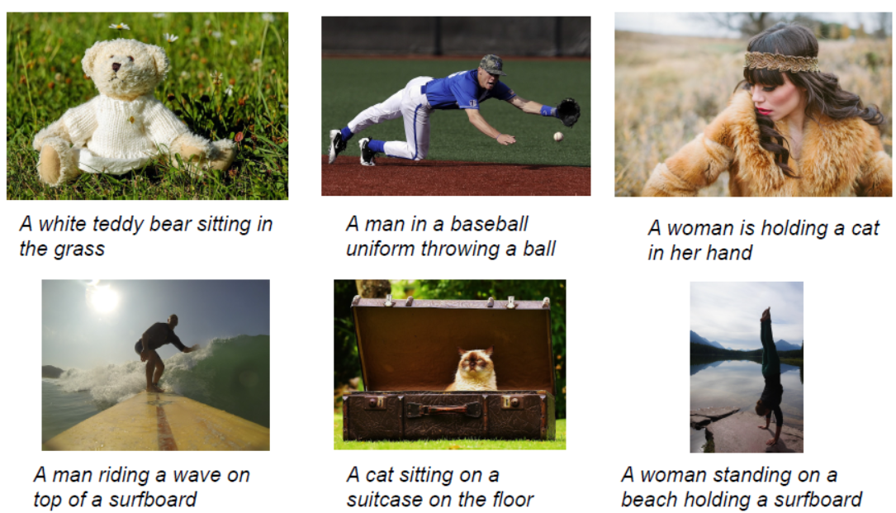
CNN Applications: Image Captioning
Source: Vinyals et al., 2015, Karpathy and Fei-Fei, 2015

Slide 48
Why not Fully Connected Net?
Think about a 12 megapixel image:
# pixel = 4247 x 2826
Possible approach
Convert the matrix to vector
Apply Fully connected layer
Let us do a simple math
One hidden layer with 10000 neurons and 10 class
# parameters =
(4247 x 2826 x 10000) + (10000 x 10) + (10000 + 10)

Slide 49
Building Blocks of CNN
Convolutional layer operation
Performs Convolution operations
Pooling layer
Performs pooling operation
Usually max pooling
Fully connected layer
Activation layer: relu, sigmoid etc.

Slide 50
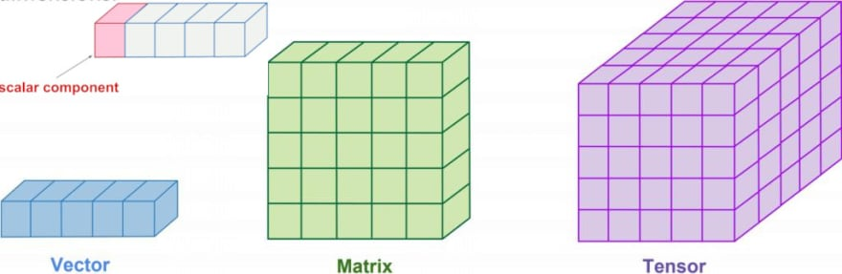
Few useful Definitions
Vector: One dimensional array of n elements
Matrix: Two dimensional array
Tensor: Multi-dimensional array

Slide 51
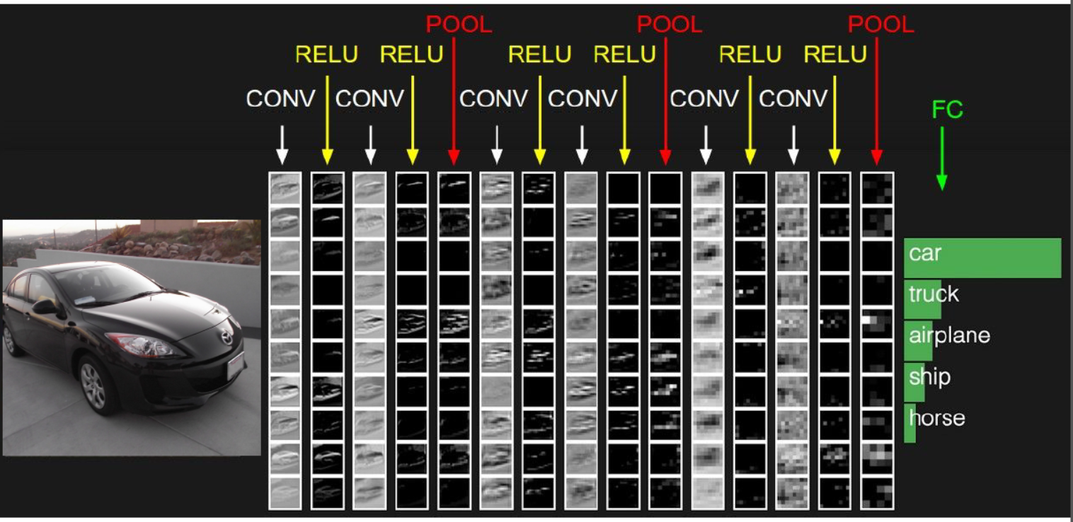
CNN: An Example

Slide 52
Convolutional Operation

Slide 53
Convolution Over Grey image (1 channel)
image
filter
output
$$\begin{matrix}0 & 2 & 1 & 5 \\ 1 & 7 & 3 & 1 \\ 2 & 0 & 1 & 1 \\ 1 & 7 & 5 & 9\end{matrix}$$
convolution
$$\begin{matrix}1 & 1 \\ 0 & 1\end{matrix}$$
$$\begin{matrix}9 & 7 \\ 9 & 11\end{matrix}$$
Filter in CNN: a parameter matrix that we train using data
$$\begin{matrix}w_{11} & w_{12} \\ w_{21} & w_{22}\end{matrix}$$

Slide 54
Convolution Over Grey image: Multiple filter
image
Filter 1
Filter 2
Filter 3
$$\begin{matrix}0 & 2 & 1 & 5 \\ 1 & 7 & 3 & 1 \\ 2 & 0 & 1 & 1 \\ 1 & 7 & 5 & 9\end{matrix}$$
convolution
$$\begin{matrix}1 & 1 \\ 0 & 1\end{matrix}$$
$$\begin{matrix}1 & 0 \\ 0 & 1\end{matrix}$$
$$\begin{matrix}1 & 1 \\ 1 & 1\end{matrix}$$
Output
(Tensor)
$$\begin{matrix}9 & 7 \\ 9 & 11\end{matrix}$$
$$\begin{matrix}7 & 2 \\ 9 & 10\end{matrix}$$
$$\begin{matrix}10 & 10 \\ 10 & 16\end{matrix}$$

Slide 55
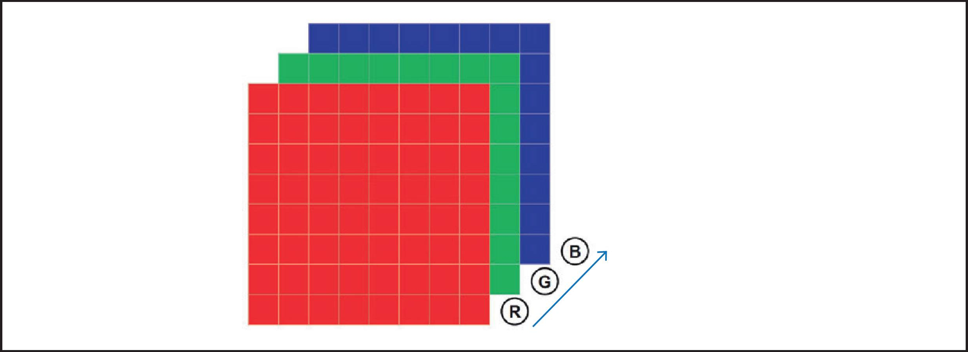
Color Image: RGB
3 channels: Red, Green, Blue

Slide 56
Convolution Over RGB image (multi-channel)
R
G
B
$$\begin{matrix}a & b & c & d \\ h & g & f & e \\ i & j & k & l \\ p & o & n & m\end{matrix}$$
$$\begin{matrix}c & b & a & d \\ h & g & h & e \\ p & j & k & k \\ c & o & t & y\end{matrix}$$
$$\begin{matrix}o & h & c & k \\ g & t & f & e \\ f & j & e & l \\ x & y & z & w\end{matrix}$$
Filter
(tensor)
$$\begin{matrix}a_{11} & a_{12} \\ a_{21} & a_{22}\end{matrix}$$
$$\begin{matrix}b_{11} & b_{12} \\ b_{21} & b_{22}\end{matrix}$$
$$\begin{matrix}c_{11} & c_{12} \\ c_{21} & c_{22}\end{matrix}$$
Output
(matrix (2 x2))

Slide 57

Convolution Over RGB image: Multiple Filter
R
G
B
$$\begin{matrix}a & b & c & d \\ h & g & f & e \\ i & j & k & l \\ p & o & n & m\end{matrix}$$
$$\begin{matrix}c & b & a & d \\ h & g & h & e \\ p & j & k & k \\ c & o & t & y\end{matrix}$$
$$\begin{matrix}o & h & c & k \\ g & t & f & e \\ f & j & e & l \\ x & y & z & w\end{matrix}$$
Filter 1
Filter 2
Filter 3
Output
2x2x3

Slide 58
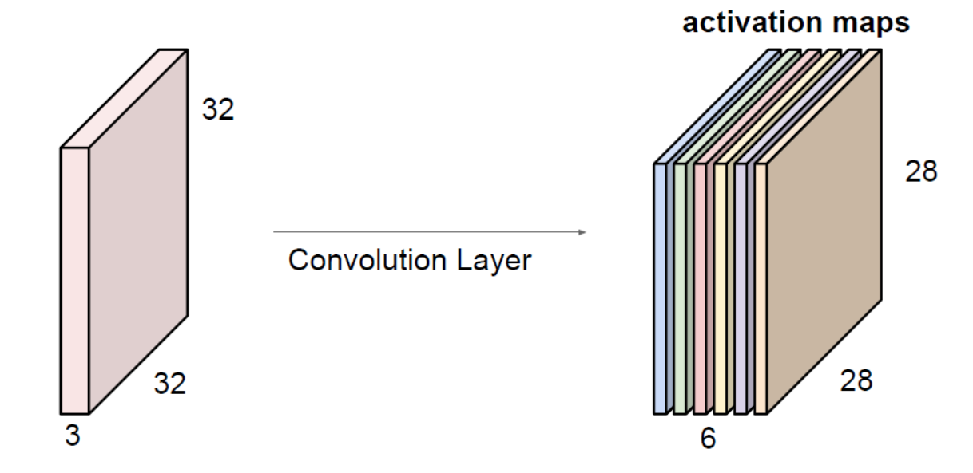
Convolution Layer: Pictorial view
5 X 5 filters
# filters = 6

Slide 59
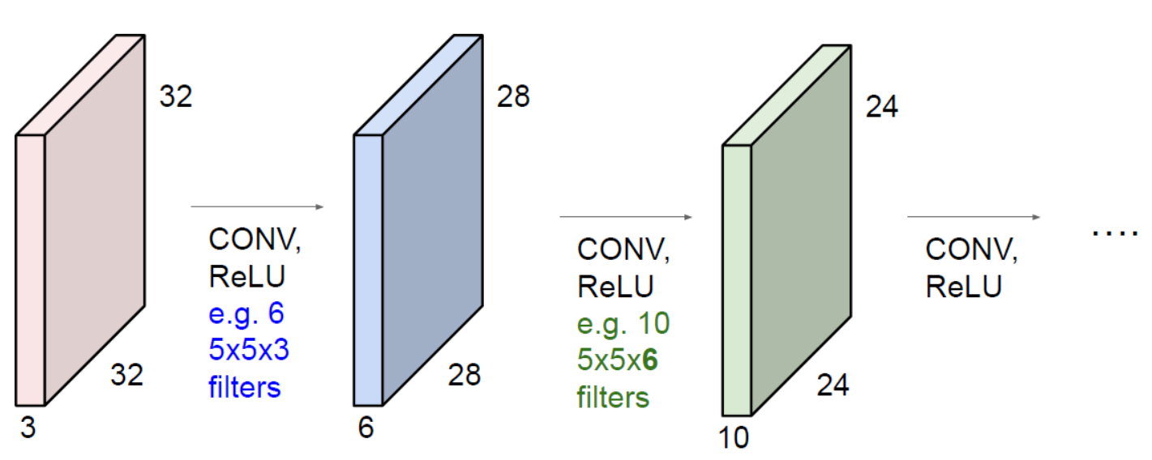
Sequence of Convolution in CNN
ConvNet is a sequence of Convolution Layers, interspersed with activation functions

Slide 60

Stride (extent of overlap)
$$\begin{matrix}a & b & c & d \\ h & g & f & e \\ i & j & k & l \\ p & o & n & m\end{matrix}$$
Stride = 1

Slide 61
Stride (extent of overlap)
$$\begin{matrix}a & b & c & d \\ h & g & f & e \\ i & j & k & l \\ p & o & n & m\end{matrix}$$
Stride = 1

Slide 62
Stride (extent of overlap)
$$\begin{matrix}a & b & c & d \\ h & g & f & e \\ i & j & k & l \\ p & o & n & m\end{matrix}$$
Stride = 1

Slide 63
Convolution Layer: Summary
Let us assume input is n1 x m1 x C
Conv layer needs 4 hyper-parameters:
Number of filters K
The filter size F
The stride S
The zero padding P
This will produce an output of n2 x m2 x K
Where:
n2 = (n1 - F + 2P)/S + 1
m2 = (m1 - F + 2P)/S + 1
Number of parameters: $F^{2}$CK and K biases

Slide 64
Pooling

Slide 65
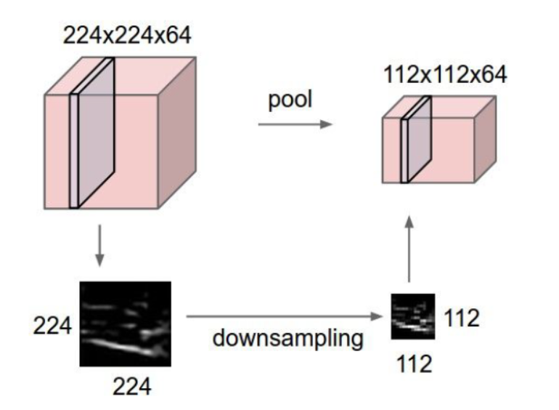
Pooling Layer
makes the representations smaller and more manageable
operates over each activation map independently

Slide 66
Pooling Layer: Summary
Let us assume input is n1 x m1 x c1
Pooling layer needs 2 hyper-parameters:
The spatial extent F
The stride S
This will produce an output of n2 x m2 x c2 where:
n2 = (n1 - F )/S + 1
m2 = (m1 - F)/S + 1
Number of parameters: 0

Slide 67
Fully Connected Layer
Fully connected layer
Feature
vector
output
Input
Conv
Conv
Pooling

Slide 68
Popular CNN Architectures

Slide 69
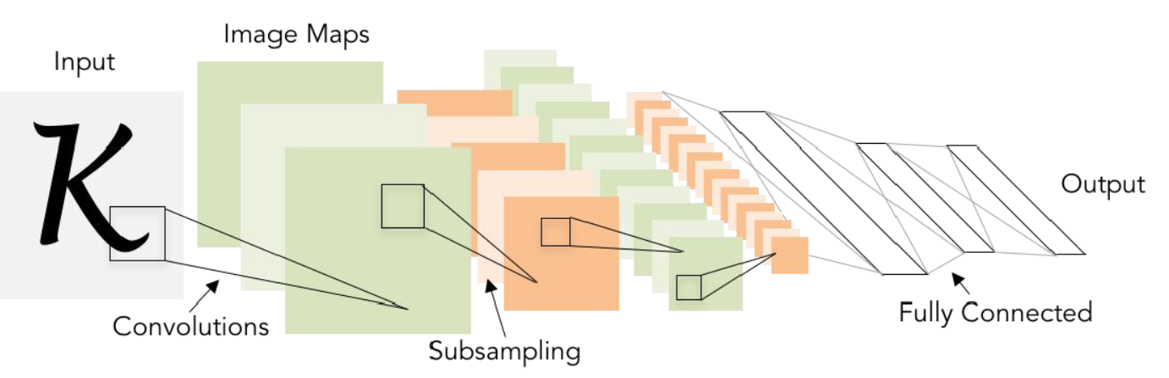
Lenet-5
Conv filters of size 5x5, with stride 1
Pooling layers were 2x2 applied with stride 2
The architecture is [CONV-POOL-CONV-POOL-FC-FC]

Slide 70
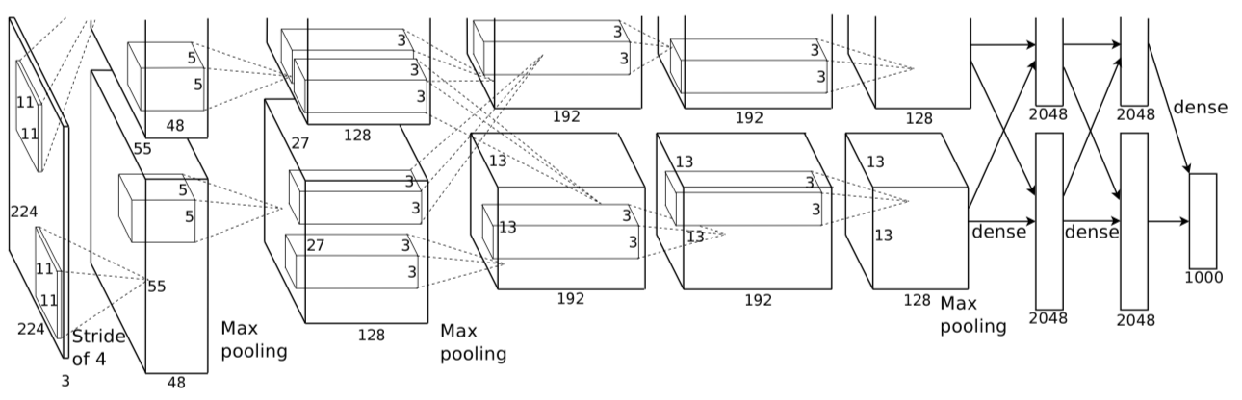
Alexnet
AlexNet architecture (1000 class data):
[227x227x3] INPUT
[55x55x96] CONV1: 96 11x11 filters at stride 4, pad 0
[27x27x96] MAX POOL1: 3x3 filters at stride 2
[27x27x96] NORM1: Normalization layer
[27x27x256] CONV2: 256 5x5 filters at stride 1, pad 2
[13x13x256] MAX POOL2: 3x3 filters at stride 2
[13x13x256] NORM2: Normalization layer
[13x13x384] CONV3: 384 3x3 filters at stride 1, pad 1
[13x13x384] CONV4: 384 3x3 filters at stride 1, pad 1
[13x13x256] CONV5: 256 3x3 filters at stride 1, pad 1
[6x6x256] MAX POOL3: 3x3 filters at stride 2
[4096] FC6: 4096 neurons
[4096] FC7: 4096 neurons
[1000] FC8: 1000 neurons (class scores)

Slide 71
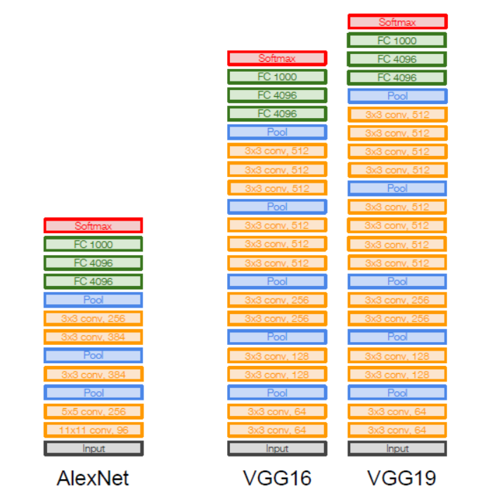
VGGNet
Small filters, deeper network
3x3 CONV stride 1, pad 1
2x2 MAX POOL stride 2

Slide 72
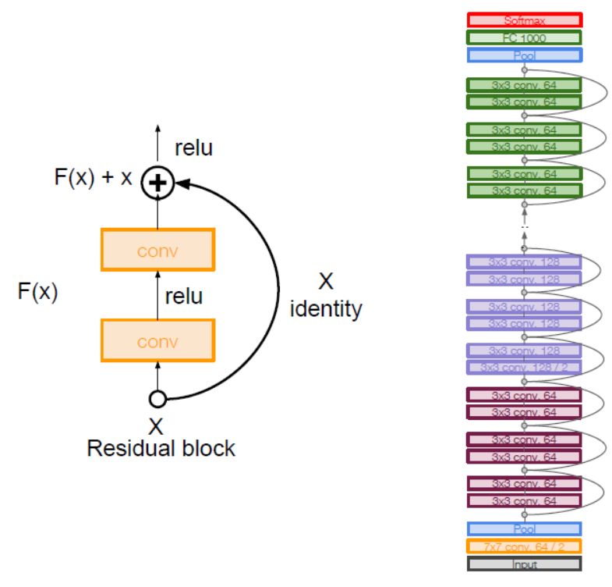
Resnet
Very Deep Nets with Residual Connections

Slide 73
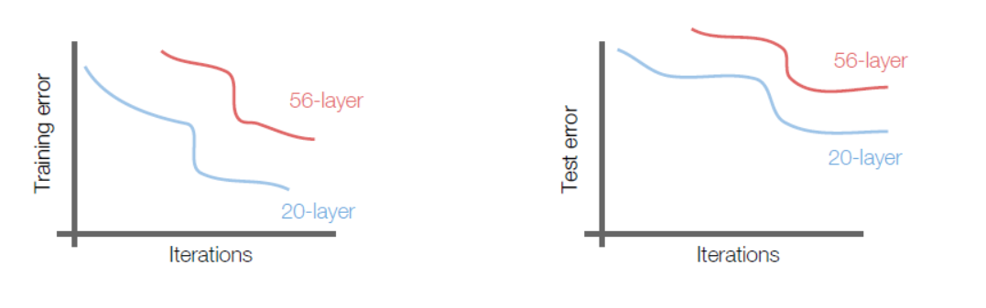
Resnet
What happens if we continue stacking deeper layers on a plain convolutional neural net?
56-layer model performs worse on both training and test error
The deeper model performs worse, but it’s not caused by overfitting!

Slide 74
Resnet: Design Principles
Deeper models are harder to optimize
The deeper model should be able to perform at least as well as the shallower model.
A solution by construction
Copy the learned layers from the shallower model
Set additional layers to identity mapping.

Slide 75
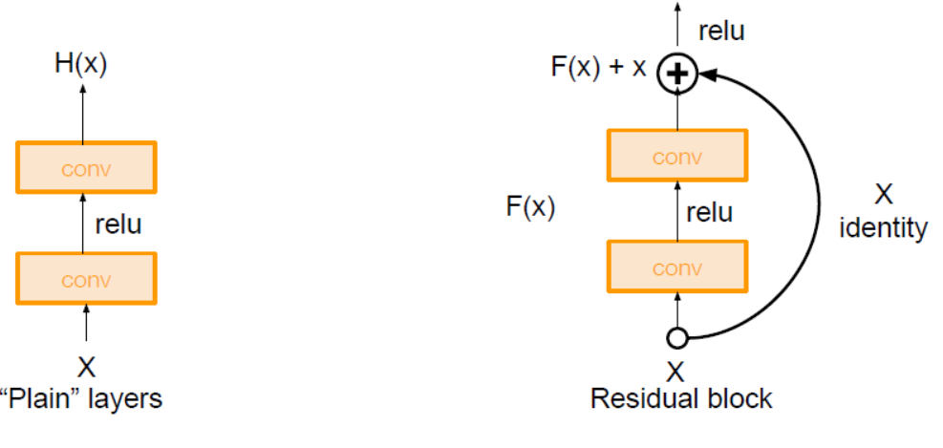
Resnet: Residual Block

Slide 76
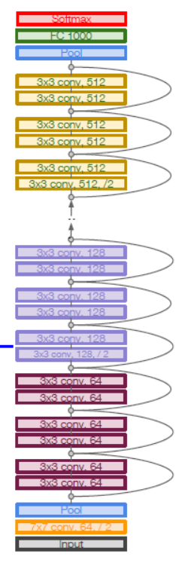
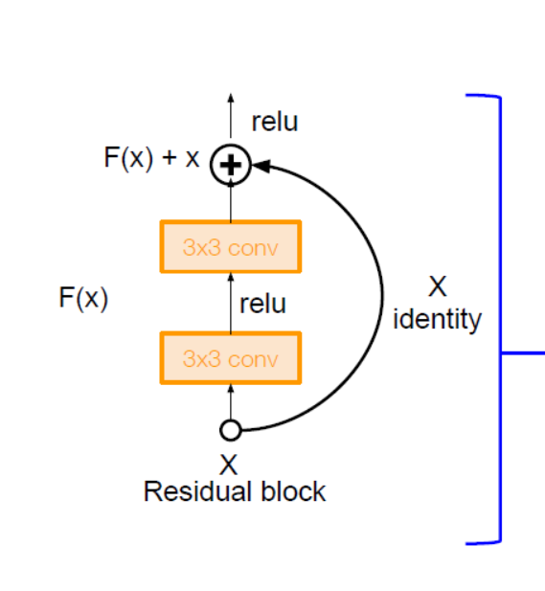
Resnet Full Architecture
Stack residual blocks
Every residual block has two 3x3 conv. layers

